Slide 1
Efficiency and Bus Fleet Management: Strategic Communications and quantifying GHG and other co-benefits (#BBUS)
M1 & M3 LR+Model+ Framework+Questionnaire
June 2026
© Council on Energy, Environment and Water, 2026

Slide 2

Impacting sustainable development at scale with data, integrated analysis, and strategic outreach
TRANSFORMATIONS
QUALITY OF LIFE
ENABLERS
390+
Multidisciplinary team
550+
Peer-reviewed publications
700+
Convenings
400 million+
Lives impacted
11
Union ministries supported
20+
State governments supported
Low-carbon Economy
Clean Air
Sustainable Finance
Energy Transitions
Sustainable Water
Technology Futures
Power Markets
Sustainable Food Systems
Circular Economy
Industrial Sustainability
Sustainable Cooling
Climate Resilience
Sustainable Livelihoods
Sustainable Mobility
International Cooperation
SPECIAL INITIATIVES
CEEW Green Finance Centre
Powering Livelihoods
Emerging Economies
UP State Office

Slide 3
The project’s key components
M1 - Socio-economic co-benefits, especially for women, low-income groups, & vulnerable road users
M2 - Health and air quality benefits from increased bus usage and reduced reliance on private vehicles
4-in-1 co-benefits model of bus-based public transport
M3 - Greenhouse gas (GHG) mitigation potential benefits
of bus deployment
M4 - Resilience & adaptive benefits of robust bus transport on the economy and physical infrastructure
Easing access to climate, green funds and other potential avenues for bus and allied infrastructures
Build institutional support for bus systems through strategic communication
Source: CEEW compilation

Slide 4

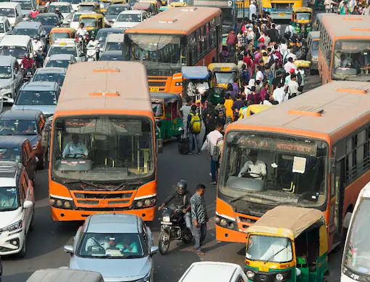




Criteria for study geography selection
Population: Below 10 lakh - Medium, 10 to 40 lakh - Large, 40 lakh to 1 Crore - Metro, 1 Crore and above - Mega
Socio economic status (annual per capita income): Below INR 95000 - Low income, INR 95000 to 370000 - Lower middle income, Above INR 370000 - Upper middle income
Extent of PT supply(Buses per lakh population): Above 60 - LOS 1, 40 to 60 - LOS 2, 20 to 40 - LOS 3, Below 20 - LOS 4
Annual PM2.5 levels: Below 40 μg/m3 - Compliant, Above 40 μg/m3 - Non-compliant
Climate vulnerability (exposure to events - floods, droughts, cyclones): [High(0.41-1), Medium(0.21-0.40), Low(0.00-0.20)]
Source: CEEW compilation

Slide 5


Geographies in focus
Group A: Cities with bus systems
Bengaluru: A megacity in South India featuring
A well-maintained fleet and a broad user spectrum.
An essential site for studying transit-oriented resilience amid escalating climate vulnerabilities, such as seasonal flooding and urban heat.
Jaipur: One of the fastest-growing cities in Northern India with
A fleet of buses operational for more than 10 years, and new bus inductions scheduled in the coming year.
A heavy tourist population mix in its service coverage.
Heavy air pollution during the winter season.
Bhubaneswar: An emerging city in eastern India with
A modern, award-winning, tech-enabled, inclusive transit system.
High climate vulnerability, especially heavy rains and cyclones.
6500-7000 buses
12 million (2025 est.)
300-400 buses (+450 in coming years)
4.5 million (2025 est.)
500+ buses
1.4 million (2025 est.)
Source: CEEW compilation

Slide 6
Geographies in focus
Group B: Cities with soon to be operational bus systems
Jodhpur: An emerging city in North India
First time adopter of electric buses
An essential site for studying transit-oriented resilience amid escalating climate vulnerabilities, such as seasonal flooding and urban heat.
Puducherry: One
A fleet of
Gandhinagar:
A
100 e-buses
1.2 million (2025 est.)
75 e-buses
0.35 million (2025 est.)
100 e-buses
4 million (2025 est.)
Source: CEEW compilation

Slide 7
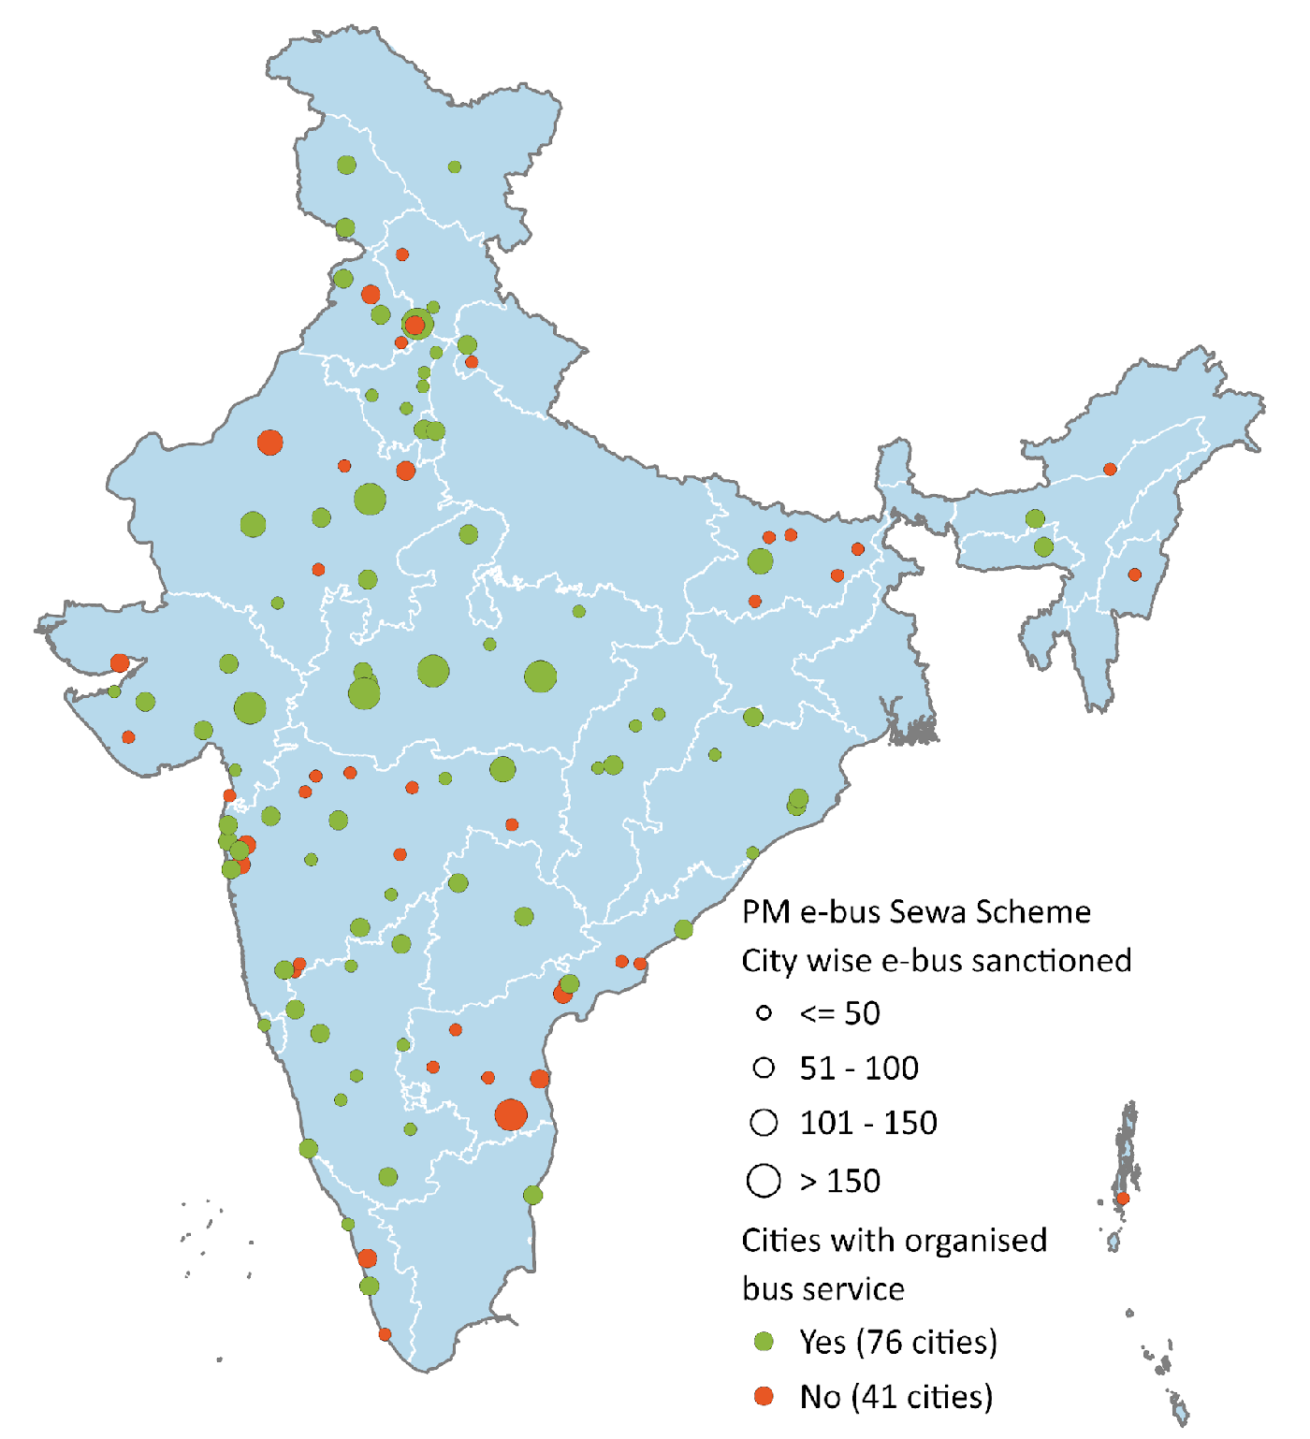

PM e-Bus Sewa scheme is launching public bus transport in 100+ Indian cities
As part of the Government of India’s PM e-Bus Sewa scheme, 10,000 electric buses will be deployed in 100+ Indian cities. The main criterion for this scheme is a city population between 3 and 40 lakh.
Figure 1: PM-eBus Sewa covers 117 cities across 26 states & UTs
These cities are growing
50% population share amongst India’s Class I cities 45% of India’s start-ups originated from non-metro cities, falling within this population range⁵ High capital investments in flexible workspaces, residential projects, data centres, etc.⁶
These cities also face challenges
81 out of the 131 NCAP cities of India; these cities consistently struggle with poor air quality throughout the year.⁷ Unchecked urban expansion and low-density development due to lack of regulated planning.⁸
India has 450+ cities with a population above 1 lakh – Class I cities¹
300+ cities with a population between 1 and 3 lakh²
PM e-Bus Sewa focus
140+ cities with a population between 3 and 40 lakh³
9 cities with a population above 40 lakh⁴
Source: Authors’ compilation
7|
Source: 1,2,3. Census 2011; 4. PIB 2025, 5. PIB 2024, 6. Colliers 2025, 7. MoEFCC; 8. Ramanna 2025
UT: Union territory
Notes:
Change the map

Slide 8
Geographies in focus
Group B: Cities with no operational bus systems (discussion with MoHUA ongoing to finalise 3 cities)
Jodhpur: Blue city , Tourism Hotspot
Major tourism and heritage city known for Mehrangarh Fort and the “Blue City” landscape.
Important regional centre for handicrafts, defence establishments, and desert trade.
Puducherry :coastal union territory city with French Colonial heritage and tourism
Famous for French architecture, beaches, and cultural tourism.
Emerging centre for education, wellness tourism, and small-scale industries.
Gandhinagar: One of the important Hindu pilgrimage Cities
One of the seven holiest Hindu pilgrimage cities situated along the Ganga River.
Hosts major religious gatherings like Kumbh Mela and attracts millions of tourists annually.
Gaya: A globally significant Buddhist and Hindu pilgrimage city
Important religious destination for both Hindu rituals and Buddhist pilgrimage tourism.
Home to nearby Bodh Gaya, where Gautama Buddha attained enlightenment.
Bilaspur: An important railway, educational, and administrative hub
Key railway and administrative hub in central India with strong regional connectivity.
Emerging educational and commercial centre supporting nearby industrial and mining regions.
Tirupati: prominent pilgrimage and temple city in Andhra Pradesh
Home to the Tirumala Venkateswara Temple, one of the world’s most visited temples.
Growing educational and tourism economy supported by religious travel.

Slide 9
Structure of the Presentation – Model 2
Structure of the Presentation – Model 2
Overview of Model 2
Why Health and Air Quality Benefits Matter in Bus Systems
Literature Review and Key Learnings
Model 2 Framework
Key Parameters and Variables
Data Requirements and Possible Sources
Primary Survey Inputs Required for Model 2
Draft Questionnaire Structure

Slide 10
Deep dive in M2: Health Co-benefits Model Literature review — geographic coverage & key papers (Use 11 papers)
Model 2 quantifies bus-related health co-benefits through reduced pollution exposure, lower road injury risk, reduced commute stress, and increased active travel.
Geography | Papers/Reports | Count | Share
North America | Maizlish San Francisco, Besser USA, Saelens King County, Legrain Montréal, duplicate Saelens file | 5 | 45%
Europe / UK | Madrid, HIA Scotland Guide, On the Buses London, Coimbra | 4 | 36%
Asia / Middle East | Tehran low-emission transport system | 1 | 9%
Global / Review | Raza air-pollution HIA review | 1 | 9%
Literature Review — Geographic Coverage (n = 10 unique studies) North America 40%, Europe/UK 40%, Asia/Middle East 10%, Global Review 10%
Key inference: Most available evidence comes from North America and Europe/UK. India-specific evidence on bus-related health co-benefits is limited, especially for small and medium cities.
BBUS contribution: BBUS will fill this gap by combining primary surveys, GIS-based exposure mapping, health indicators, and Indian city-level bus deployment data.
10|

Slide 11
Deep dive in M2: Health Co-benefits Model Pathways of Health Benefits from Bus-Based Public Transport
Bus deployment / improved bus service
Increased bus access and bus usage
Reduced dependence on private vehicles
Health benefit pathways
Health benefit pathways
1. Active Travel Gains
Walking to and from bus stops increases daily physical activity.
2. Air Pollution Exposure Reduction
Mode shift from private vehicles to buses can reduce PM2.5/NO2 exposure and emissions.
3. Road Safety Benefits
Shift from two-wheelers/cars/shared modes to buses can reduce crash and injury exposure.
4. Commute Stress Reduction
Reliable, affordable, safe, and comfortable bus services can reduce daily commute stress.
11|

Slide 12
Deep dive in M2: Health Co-benefits Model Models identified from literature
Integrated Transport and Health Impacts Model (ITHIM) Links travel behaviour, physical activity, PM2.5 exposure, road injuries, and DALYs.
Health Impact Assessment (HIA) Structures health pathways, affected population groups, and monitoring indicators.
Comparative Risk Assessment (CRA) Converts exposure changes into health burden using relative-risk functions.
Difference-in-Differences (DiD) / Natural Experiment Estimates pre-post impact of new bus deployment in Group B cities.
GLM / Multivariate Regression Estimates health outcomes while controlling for income, gender, education, and city differences.
Ordered Logit / Ordered Probit Models commute stress and perception-based outcomes measured on 1–5 scales.
GIS / Spatial Exposure Analysis Maps bus access, walking distance, PM2.5 exposure, and crash-risk exposure.
A-S-I Co-benefits Framework Links Avoid–Shift–Improve actions with emissions reduction and public health benefits.
12|

Slide 13
Deep dive in M2: Health Co-benefits Model Groupwise Model Selection
Group A - Cities with buses
Group B - Buses incoming
Bengaluru | Jaipur | Bhubaneswar
Haridwar | Gaya | Jodhpur etc
Multivariate Regression
Method: Cross-sectional regression + GIS exposure analysis
Since buses are already operating in Group A cities, the model will assess the current relationship between bus access, bus use, and health outcomes. Bus users, non-users, and private vehicle users will be compared based on walking activity, pollution exposure, road-safety experience, commute stress, and self-reported health indicators.
GIS/lat-long data will be used to measure actual bus accessibility, such as distance to nearest bus stop, 500 m catchment coverage, walking access/egress distance, and route-level exposure. Regression models will then control for income, gender, education, age, vehicle ownership, and city/ward differences.
Difference in Difference(DiD)
Method: Pre-post Difference-in-Differences + GIS exposure analysis
In Group B cities, new bus deployment creates a before-and-after evaluation opportunity. The model will track health-related changes before and after bus services begin, comparing people who become connected to the new bus system with people who remain outside the bus catchment area.
The treatment group will include respondents whose home/destination becomes connected to new bus routes or stops. The control group will include similar respondents without direct bus access. The Difference-in-Differences model will estimate the actual impact of bus deployment on active travel, pollution exposure, road-safety risk, commute stress, and health outcomes.
Source:

Slide 14
Common Input Variables across M2 Models
1. Travel Behaviour
Current mode, previous mode, trip purpose, trip distance, travel time, travel cost, transfers, bus-use days per week
2. Bus Access and Service Quality
Distance to nearest bus stop, access/egress walking time, bus frequency, waiting time, reliability, crowding, fare, safety, comfort
3. Road Injury Reduction Variables
Previous mode risk, near-miss experience, crash/injury history, unsafe crossing near bus stop, footpath availability, lighting, crash hotspot exposure
4. GIS / Spatial Inputs
Home lat-long, destination lat-long, bus stop location, route alignment, 500 m catchment, PM2.5 layer, crash hotspot location
5. Pollution Reduction Variables
Previous private vehicle mode, vehicle-km reduced, route-level PM2.5/NO2 exposure, roadside waiting exposure, exposure before and after bus use
6. Control Variables
Age, gender, income, education, occupation, vehicle ownership, disability/mobility limitation, city/ward, baseline health condition
Use across models These inputs feed ITHIM, HIA/CRA, DiD, GLM/Regression, Ordered Logit, and GIS exposure models to estimate active travel gains, pollution reduction, injury reduction, stress reduction, DALYs averted, and hospitalisation cost savings.
14|

Slide 15
Expected Outputs from M2: Health Co-benefits Model
1. Active Travel Benefits
Extra walking minutes gained through bus access and egress Share of users achieving recommended daily physical activity DALYs averted from increased physical activity
2. Air Pollution Benefits
Reduction in PM2.5 / NO2 exposure during commute Reduction in private vehicle-km due to bus mode shift Respiratory and cardiovascular health-risk reduction
3. Road Safety Benefits
Reduction in crash and injury exposure after shifting to bus Near-miss / injury risk reduction for bus users Fatalities and serious injuries avoided
4. Commute Stress Benefits
Reduction in commute stress score Reduction in high-stress commuters Improved perceived safety, reliability, comfort and affordability
5. Monetised Health Benefits
Hospitalisation cost saved Economic value of DALYs averted Health return on bus investment / Health SROI
Final Output Format: City-wise health co-benefits Group-wise benefits by gender, income and vulnerability Comparison of Group A and Group B cities Policy-ready indicators for MRV dashboard
15|

Slide 16
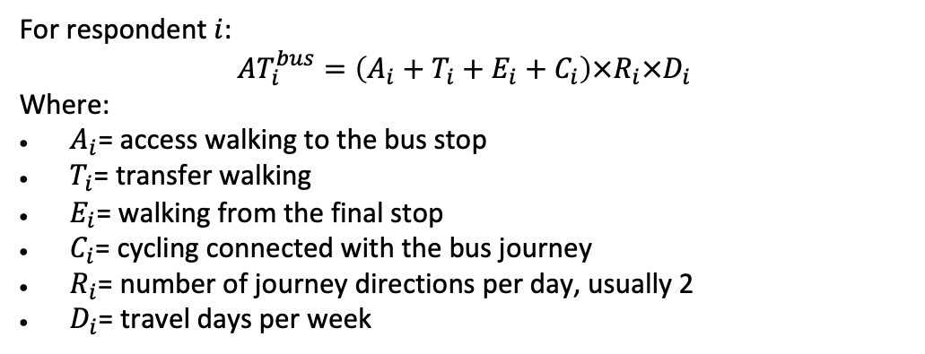
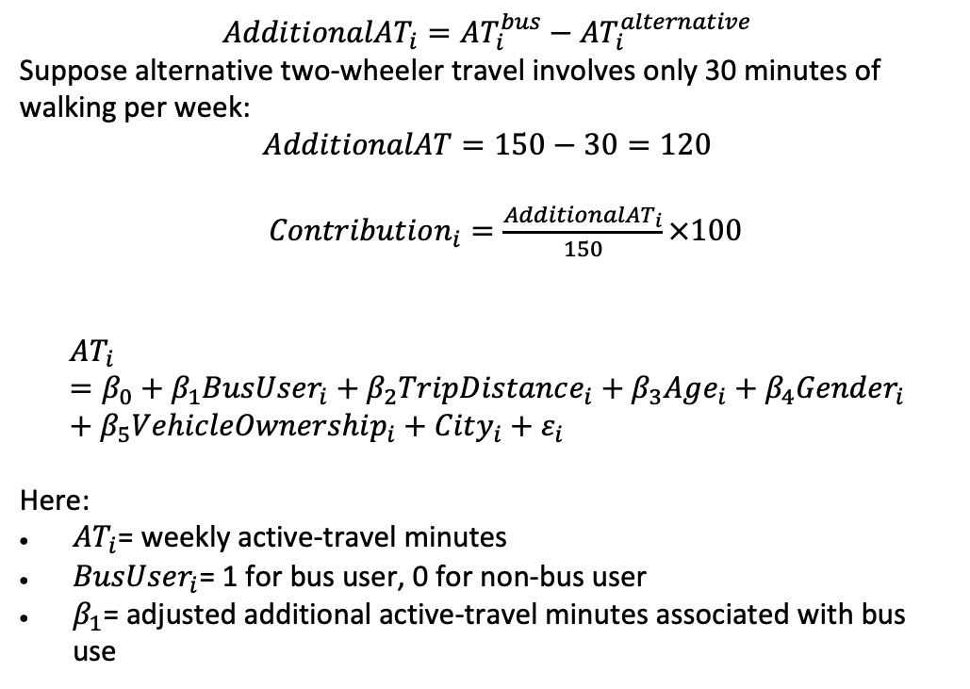
Expected Outputs from M2: Active Travel
For respondent $i$:
$$AT_{i}^{bus}=\left(A_{i}+T_{i}+E_{i}+C_{i}\right)×R_{i}×D_{i}$$
Where:
$A_{i}$= access walking to the bus stop
$T_{i}$= transfer walking
$E_{i}$= walking from the final stop
$C_{i}$= cycling connected with the bus journey
$R_{i}$= number of journey directions per day, usually 2
$D_{i}$= travel days per week
$$AdditionalAT_{i}=AT_{i}^{bus}−AT_{i}^{alternative}$$
Suppose alternative two-wheeler travel involves only 30 minutes of walking per week:
$$AdditionalAT=150−30=120$$
$Contribution_{i}=\frac{AdditionalAT_{i}}{150}×100$
$$AT_{i}=β_{0}+β_{1}BusUser_{i}+β_{2}TripDistance_{i}+β_{3}Age_{i}+β_{4}Gender_{i}+β_{5}VehicleOwnership_{i}+City_{i}+ε_{i}$$
Here:
$AT_{i}$= weekly active-travel minutes
$BusUser_{i}$= 1 for bus user, 0 for non-bus user
$β_{1}$= adjusted additional active-travel minutes associated with bus use
16|

Slide 17
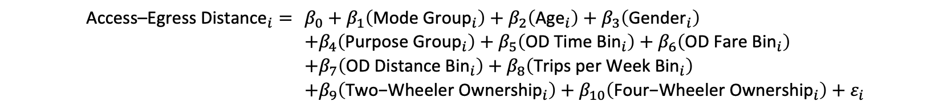
Expected Outputs from M2: Active Travel
$$\begin{aligned}{\text{Access}\text{–}\text{Egress} \text{Distance}}_{i}= &β_{0}+β_{1}\left({\text{Mode} \text{Group}}_{i}\right)+β_{2}\left({\text{Age}}_{i}\right)+β_{3}\left({\text{Gender}}_{i}\right) \\ &+β_{4}\left({\text{Purpose} \text{Group}}_{i}\right)+β_{5}\left({\text{OD} \text{Time} \text{Bin}}_{i}\right)+β_{6}\left({\text{OD} \text{Fare} \text{Bin}}_{i}\right) \\ &+β_{7}\left({\text{OD} \text{Distance} \text{Bin}}_{i}\right)+β_{8}\left({\text{Trips} \text{per} \text{Week} \text{Bin}}_{i}\right) \\ &+β_{9}\left({\text{Two}\text{−}\text{Wheeler} \text{Ownership}}_{i}\right)+β_{10}\left({\text{Four}\text{−}\text{Wheeler} \text{Ownership}}_{i}\right)+ε_{i}\end{aligned}$$
17|

Slide 18
Expected Outputs from M2: Active Travel
Variable | Variable category | Base/reference category | Coefficient (metres) | p-value
Mode: Rickshaw | Binary | Two Wheeler | +179.02 | <0.001
Age | Continuous | Not applicable; one-year increase | −1.31 | 0.092
Gender: Male | Binary | Female | −0.31 | 0.990
Purpose: Work | Binary | Other purpose | −1.14 | 0.965
OD time: Short | Binary | Long: >10 min | +8.25 | 0.744
OD fare: Low | Binary | High: >₹10 | −32.32 | 0.317
OD distance: Short | Binary | Long: >5 km | −22.79 | 0.328
Weekly trips: High | Binary | Low: <5 trips/week | −51.64 | 0.031
Two-wheeler ownership: Yes | Binary | No two-wheeler owned | +43.72 | 0.089
Four-wheeler ownership: Yes | Binary | No four-wheeler owned | +24.72 | 0.351
Constant | — | Respondent belonging to all base categories, with age = 0 | 91.14 | 0.120
18|

Slide 19
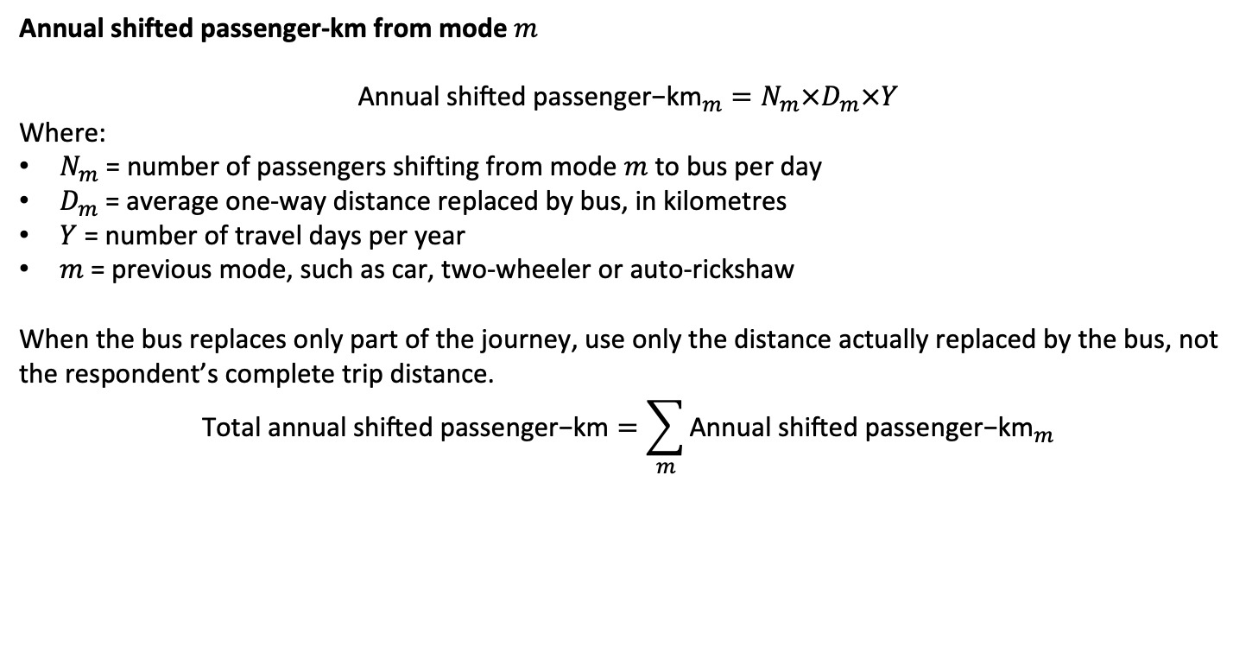
Expected Outputs from M2: Reduction in Fatalities
Annual shifted passenger-km from mode $m$
$${\text{Annual} \text{shifted} \text{passenger}\text{−}\text{km}}_{m}=N_{m}×D_{m}×Y$$
Where:
$N_{m}$ = number of passengers shifting from mode $m$ to bus per day
$D_{m}$= average one-way distance replaced by bus, in kilometres
$Y$ = number of travel days per year
$m$ = previous mode, such as car, two-wheeler or auto-rickshaw
When the bus replaces only part of the journey, use only the distance actually replaced by the bus, not the respondent’s complete trip distance.
$$\text{Total} \text{annual} \text{shifted} \text{passenger}\text{−}\text{km}=\sum_{m}{{\text{Annual} \text{shifted} \text{passenger}\text{−}\text{km}}_{m}}$$
City B: buses will be introduced
What mode do you currently use?
What is your one-way trip distance?
How many days per week do you make this trip?
Would you use the proposed bus service?
Which current mode would the bus replace?
Would it replace the full trip or only part of it?
How many days per week would you use the bus?
How would you reach and leave the bus stop?
City A: buses already operating
What is your one-way bus-trip distance?
How many days per week do you use the bus?
If this bus were unavailable, which mode would you use?
Before using the bus, which mode did you normally use?
Does the bus replace the full trip or only part of it?
How do you reach and leave the bus stop, and what is the distance?
19|

Slide 20
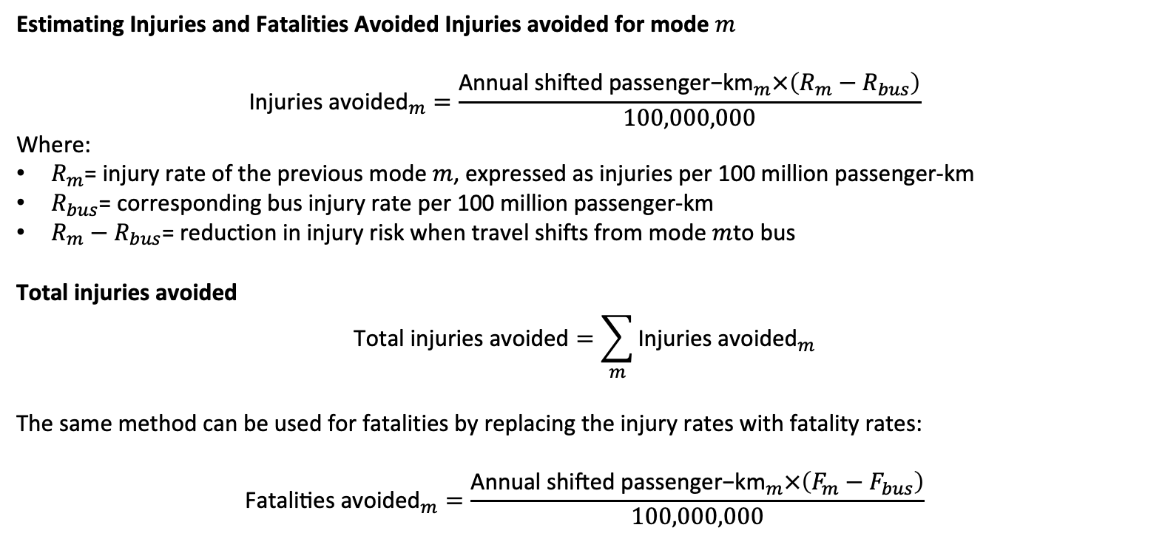
Expected Outputs from M2: Reduction in Fatalities
Estimating Injuries and Fatalities Avoided Injuries avoided for mode $m$
$${\text{Injuries} \text{avoided}}_{m}=\frac{{\text{Annual} \text{shifted} \text{passenger}\text{−}\text{km}}_{m}×\left(R_{m}−R_{bus}\right)}{100,000,000}$$
Where:
$R_{m}$= injury rate of the previous mode $m$, expressed as injuries per 100 million passenger-km
$R_{bus}$= corresponding bus injury rate per 100 million passenger-km
$R_{m}−R_{bus}$= reduction in injury risk when travel shifts from mode $m$to bus
Total injuries avoided
$$\text{Total} \text{injuries} \text{avoided}=\sum_{m}{{\text{Injuries} \text{avoided}}_{m}}$$
The same method can be used for fatalities by replacing the injury rates with fatality rates:
$${\text{Fatalities} \text{avoided}}_{m}=\frac{{\text{Annual} \text{shifted} \text{passenger}\text{−}\text{km}}_{m}×\left(F_{m}−F_{bus}\right)}{100,000,000}$$
20|

Slide 21
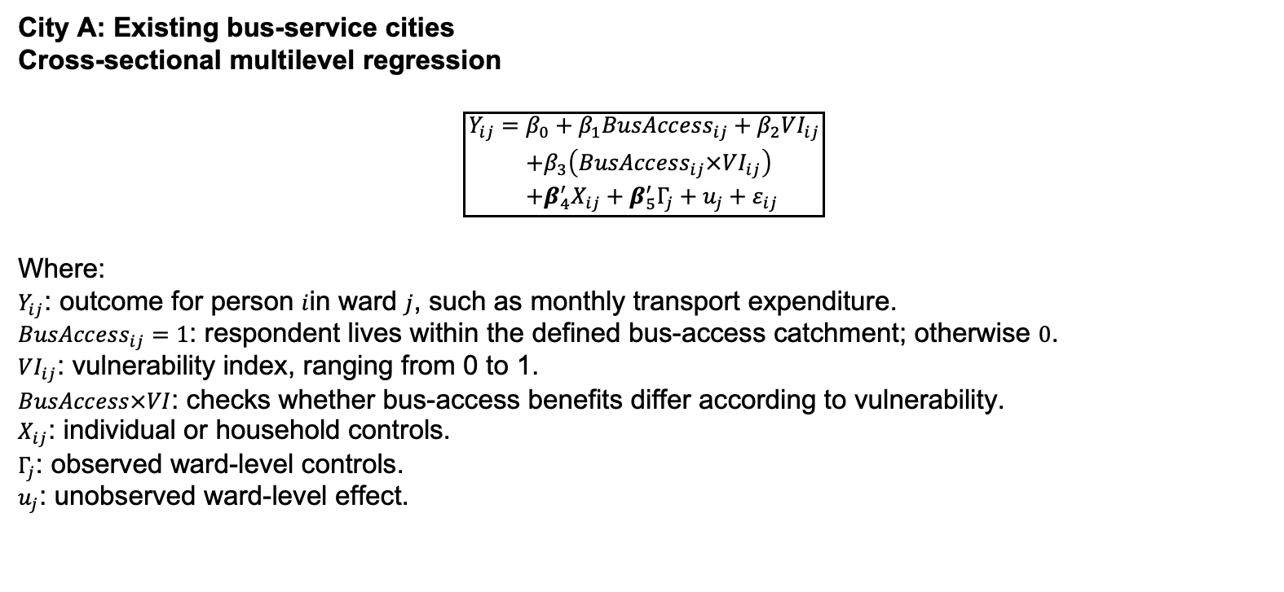
Expected Outputs from M1:City A
City A: Existing bus-service cities
Cross-sectional multilevel regression
$$\boxed{\begin{aligned}Y_{ij}=&β_{0}+β_{1}BusAccess_{ij}+β_{2}VI_{ij} \\ &+β_{3}\left(BusAccess_{ij}×VI_{ij}\right) \\ &+β_{4}^{′}X_{ij}+β_{5}^{′}Γ_{j}+u_{j}+ε_{ij}\end{aligned}}$$
Where:
$Y_{ij}$: outcome for person $i$in ward $j$, such as monthly transport expenditure.
$BusAccess_{ij}=1$: respondent lives within the defined bus-access catchment; otherwise $0$.
$VI_{ij}$: vulnerability index, ranging from 0 to 1.
$BusAccess×VI$: checks whether bus-access benefits differ according to vulnerability.
$X_{ij}$: individual or household controls.
$Γ_{j}$: observed ward-level controls.
$u_{j}$: unobserved ward-level effect.
21|

Slide 22
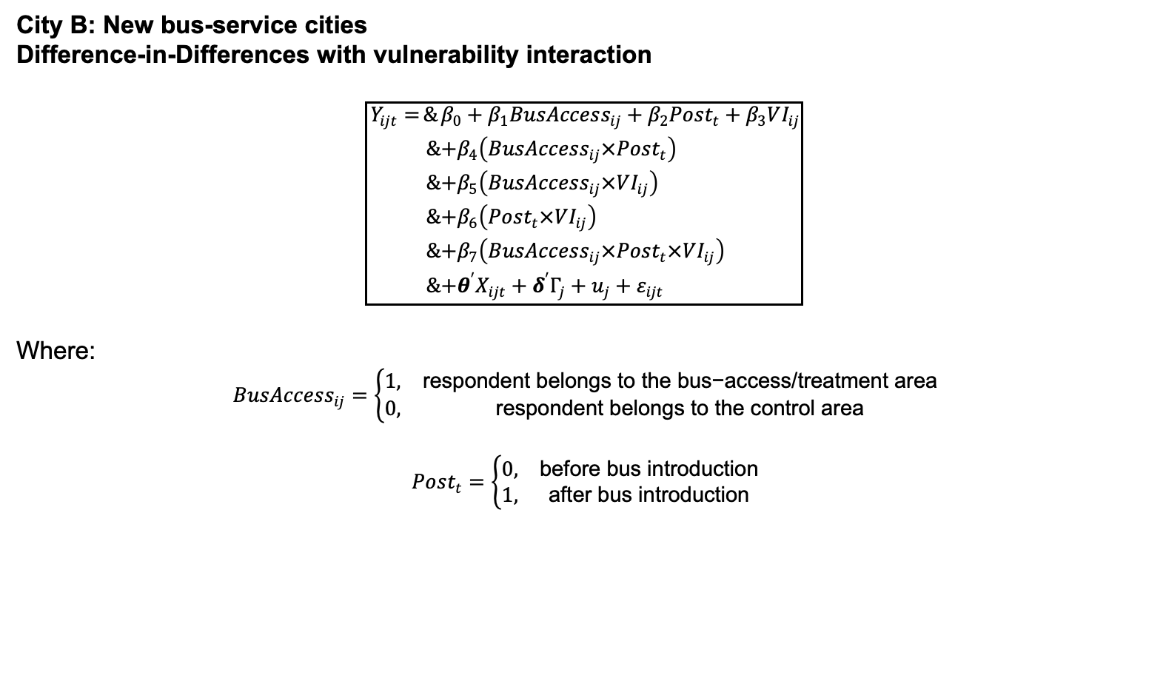
Expected Outputs from M2: City B
City B: New bus-service cities
Difference-in-Differences with vulnerability interaction
$$\boxed{\begin{aligned}Y_{ijt}=&β_{0}+β_{1}BusAccess_{ij}+β_{2}Post_{t}+β_{3}VI_{ij} \\ &+β_{4}\left(BusAccess_{ij}×Post_{t}\right) \\ &+β_{5}\left(BusAccess_{ij}×VI_{ij}\right) \\ &+β_{6}\left(Post_{t}×VI_{ij}\right) \\ &+β_{7}\left(BusAccess_{ij}×Post_{t}×VI_{ij}\right) \\ &+θ^{′}X_{ijt}+δ^{′}Γ_{j}+u_{j}+ε_{ijt}\end{aligned}}$$
Where:
$$BusAccess_{ij}=\left\{\begin{matrix}1, & \text{respondent} \text{belongs} \text{to} \text{the} \text{bus}\text{−}\text{access}\text{/}\text{treatment} \text{area} \\ 0, & \text{respondent} \text{belongs} \text{to} \text{the} \text{control} \text{area}\end{matrix}\right.$$
$$Post_{t}=\left\{\begin{matrix}0, & \text{before} \text{bus} \text{introduction} \\ 1, & \text{after} \text{bus} \text{introduction}\end{matrix}\right.$$
22|

